Slide 1
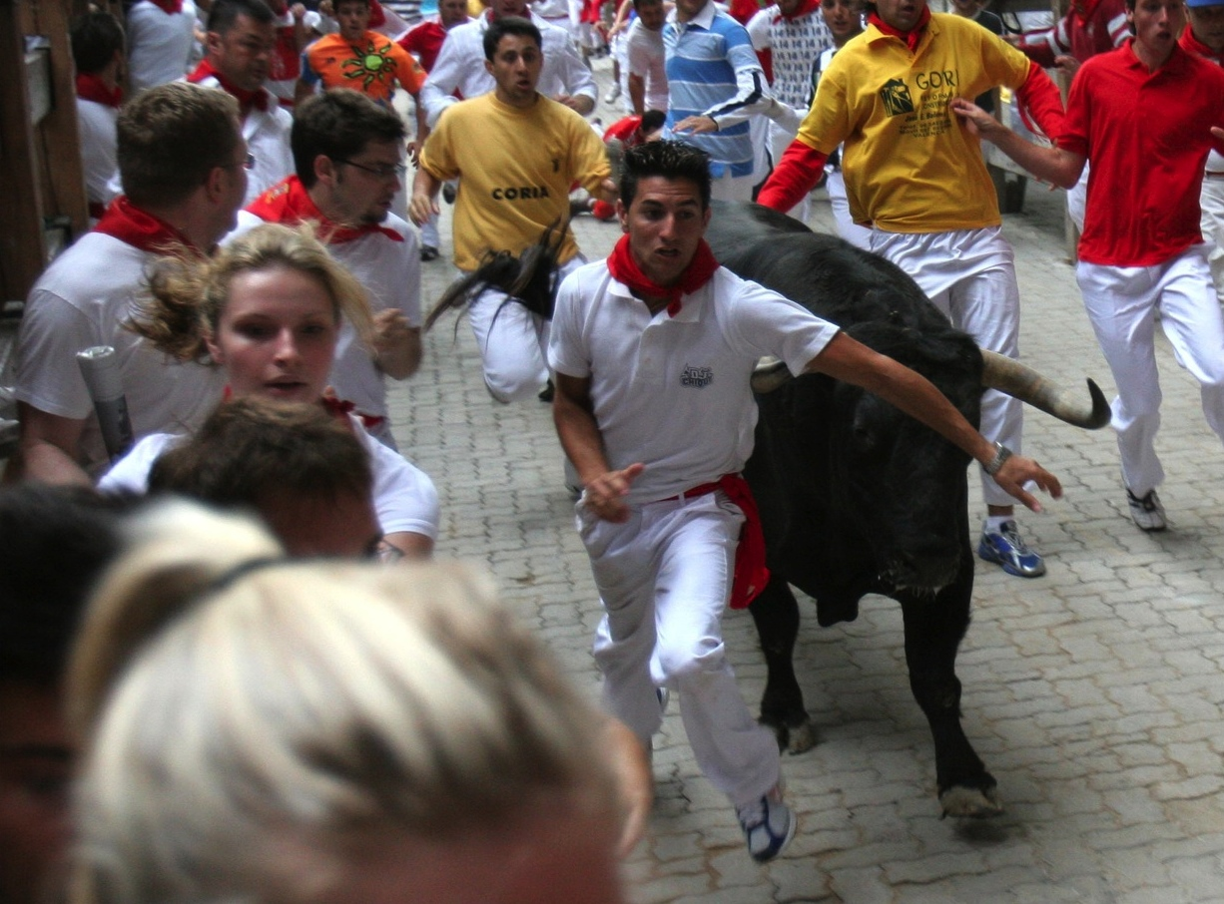
Lecture 2: requirements –or– You Want Me to Do What?
CSE 442/542 – Software Engineering

Slide 2
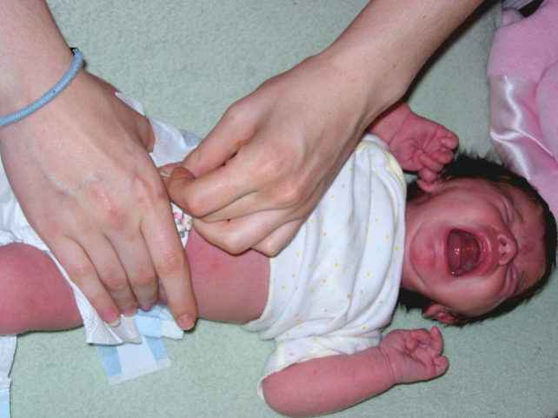
Change Happens
Notes:
Time treats software like a baby treats diaper
* Both must change for identical reasons
* Crying about the problem equally effective
Software engineers have two choices:
* Define processes which can handle change
* End up with a big, wet, smelly, poop-filled project

Slide 3
Bersoff’s “First Law”
No matter where you are in
developing a system
the system will change
& you will find
continued desire to change it

Slide 4
Why Changes Matter

Slide 5
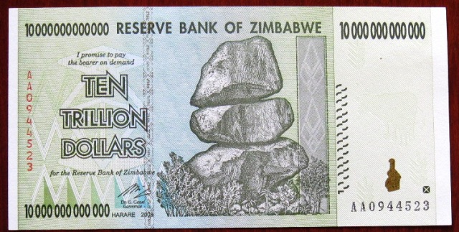
Why Changes Matter

Slide 6
What Changes Matter
Changes in business requirements
Changes in technical requirements
Changes in user requirements
other
documents
Project
Plan
data
Test Cases
code

Slide 7
Record Changes To
Requirements
Specifications
Design Documents
Source code
Comments
Test plans
Test suites
User & maintenance manuals
Standards

Slide 8
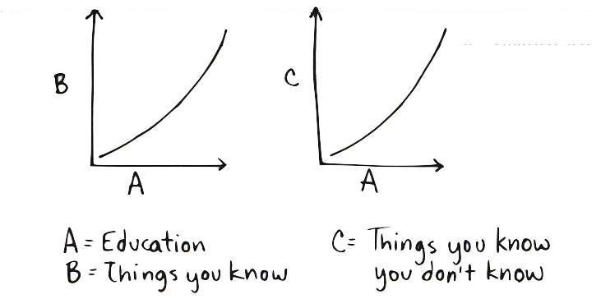
What To Record For Change
Properly handling change requires information:
Track reason why change needed
What was changed should be detailed
For the changes, any side-effects important to note
Detail of actual change should be tracked
Anything useful when apportioning blame or praise

Slide 9
Function of Version Control
Maintain integrity of your documents
Limits who can commit changes to the system
When committed, records who made each change
Provides chance to link change to other documents
Provides option to evaluate & control changes
Run scripts before & after commits to system
Changes creating bugs or defects can be rejected
Notify project with each change & show the change
Enable code to be regenerated post-commit
Publish web pages containing the changes

Slide 10
Function of Version Control
Maintain integrity of your documents
Limits who can commit changes to the system
When committed, records who made each change
Provides chance to link change to other documents
Provides option to evaluate & control changes
Run scripts before & after commits to system
Changes creating bugs or defects can be rejected
Notify project with each change & show the change
Enable code to be regenerated post-commit
Publish web pages containing the changes

Slide 11
Baselines
All documents in system at certain times
Usually found when software could be released
Further development based off of these baselines
Important to have easy way to keep system stable
Requires strictly limiting changes made to the system
Ensures project ready for demos or release
Method to roll system back to baseline needed
Projects define strict change procedures
Only acceptable changes allowed into system

Slide 12
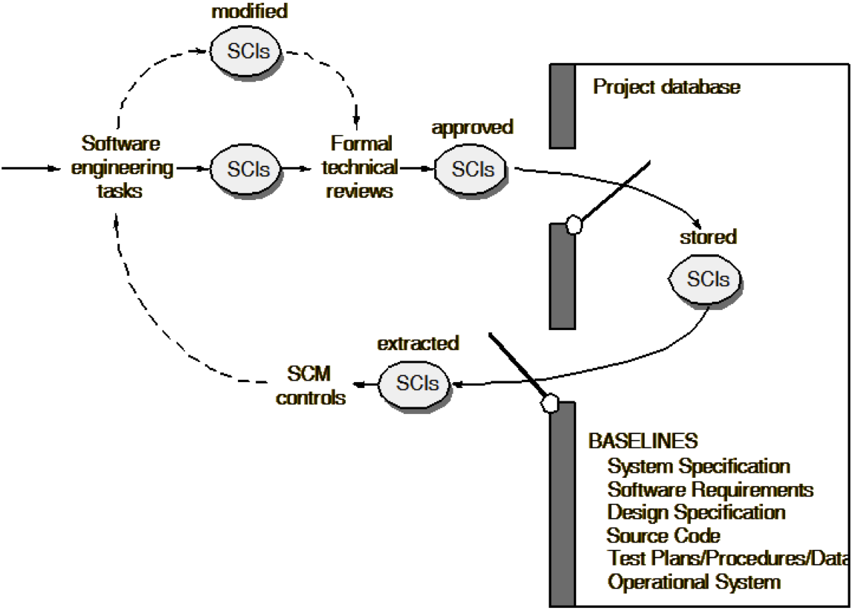
Baselines

Slide 13
Deliverable Generation
Need ability to recreate all SCIs
Any release or time should be able to be recreated
Version control can do easy part of rolling back code
Tagging releases make this even easier
May need old compilers, word processors, etc.
Harder to maintain than code
Even worse problem is maintaining hardware
Linking software to hardware is also required
What happens when hardware outdated?

Slide 14
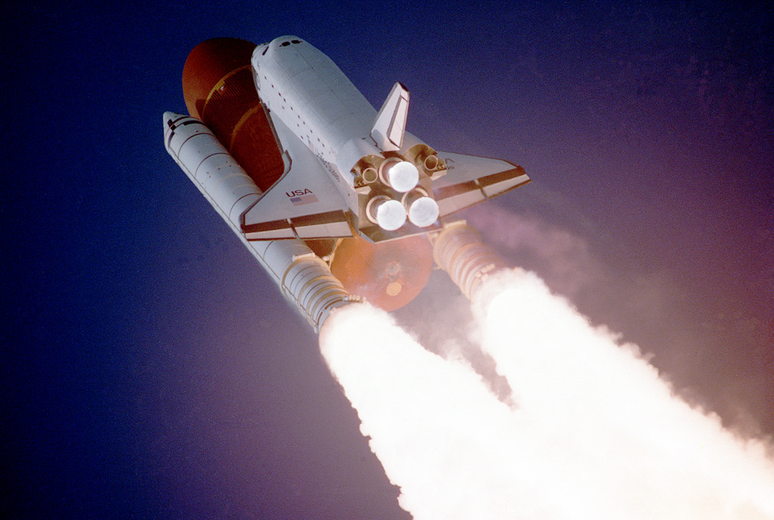
It Came From the 70s…

Slide 15
Version Control Benefits
Reduces effort managing & implementing change
All changes can be placed in context
Easier to see logic behind changes
Software integrity and security increased
Improves quality and reliability
Fired worker cannot hold project hostage
Generate information about process
Improved process & team management
Software development database automated
Better finger pointing and/or saying “I told you so”

Slide 16

What does git do for you?
Version control AND source control
Codebase and documents tracked and changes logged
Can “revert” changes – go back to a working version
Invisibly create branch in which riskier changes done
Cannot overwrite changes by warning of merge conflicts
Why git?
Very popular; among most common systems used
Likely to use this when working in industry
Cannot be the price – open-source project is free

Slide 17
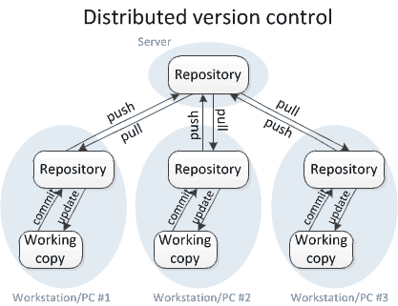
How Distributed VC Works…

Slide 18
git
Created by Linus Torvalds for Linux development
Need was great and so joined by many kernel developers
Used by popular hosting services because of stability
Since Linux changes are frequent, speed emphasized
Name meaningless (Linus suggests multiple possibilities)
Main repository hosted on remote server
Users keep local copies into which only they commit
Provides tolerance, since local changes do not pollute
Allows local experiments, can fall back to remove copy

Slide 19

Scenario
Bob writes a bug just before a big release
Result of this bug without good version control
Bug gets into codebase since no way to catch it
Client finds bug and complains about Bob
Bob has a cold winter avoiding wolves in the outdoors
Result of this bug with proper version control
Bob tries to push bug from local to remote repo
Push triggers checks and team member notices bug
Remote repo reverted to before Bob’s mistake
Program is not buggy & Bob keeps his job

Slide 20
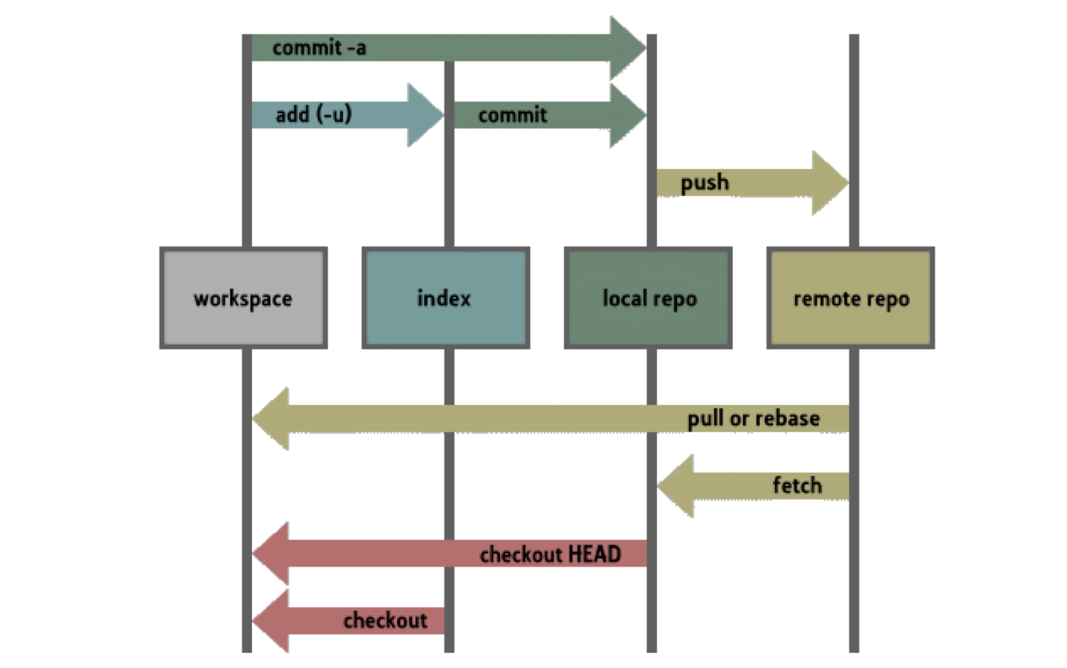
git Structure

Slide 21
Connecting git Commands
git init
Creates a new repository & allows use as remote repo
git clone
Sets up a local repo be copy of (existing) remote repo
git push
Updates remote repo with saved local changes
git pull
Updates files with changes on remote repo
Local changes guaranteed to not be overwritten
Must complete before push command allowed to work

Slide 22
Pull often
git pull requests can create merge conflicts
Local & remote changes prevent automated merger
Not just change to same file; must be on same line
Do your best to avoid this; really painful to solve
No easy solution – need to make changes manually
Manual override needed for git to move forward
Communication helps, but pull early and often!

Slide 23
Connecting git Commands
git commit
Saves all changes to local repo
Process used to add files to local repo completed
Does NOT touch remote repo; only local changed
git add
Prepares to add file to local repo
Needs commit to complete this process
Only local repo changed; does NOT touch remote repo

Slide 24
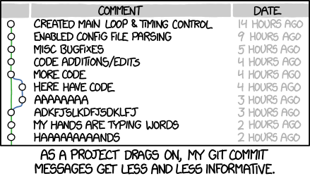
Commit messages
Many different conventions
All (but yours) sucks; choose who gets to complain
Make messages meaningful and descriptive
You will be thanked by your future self & contributors
Critical for bigger projects since vital history of work

Slide 25
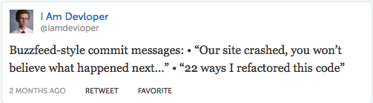
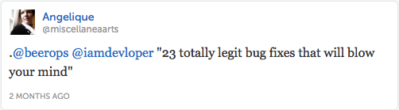
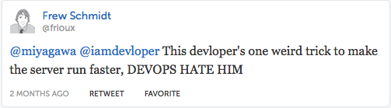
If You Have Too Much Time

Slide 26
git Branching
Useful if adding feature, refactoring code, debugging
Want all benefits of version control as you develop code
Once changes complete, need to push changes back
Want any updates & limit conflicts for later push
You half-completed code should not pollute colleagues
git includes branching options for just these cases
(As with most of this work, also true for other systems)

Slide 27
Without Branching
Susan busy fixing backend of system
Overhaul optimizes code & improves performance…
… or it will once Susan completes this work
May first make system unstable (or worse) until done
Major task takes weeks, so pushes to avoid losing work
John tinkering on frontend making cosmetic changes
But gets Susan's code in pull & sees new side effects
Assumes he caused changes and starts looking for bugs
Experience is of bugs which appear & get fixed randomly

Slide 28

Without Branching
Susan busy fixing backend of system
Improves performance, but only once complete
John tinkering on frontend making cosmetic changes
Sees system and tries to associate his changes with bugs

Slide 29
Without Branching
Huge argument about pushing incomplete code
Most tempting & easiest solution reached: JUST WAIT
Keep code local until complete so nobody else sees errors
Works great in short term; John and Susan both happy
Final work pushed & everyone is more productive

Slide 30
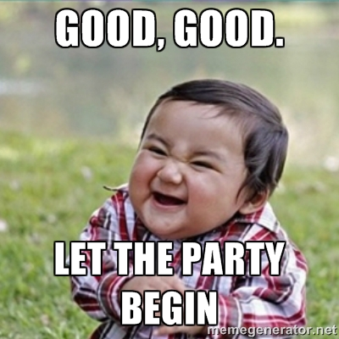
Without Branching
Huge argument about pushing incomplete code
Most tempting & easiest solution reached: JUST WAIT
Keep code local until complete so nobody else sees errors
Works great in short term; John and Susan both happy
Final work pushed & everyone is more productive

Slide 31
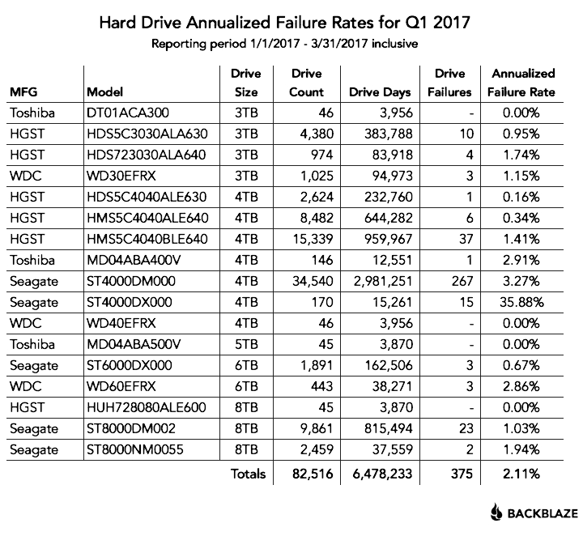
Without Branching
Huge argument about pushing incomplete code
Most tempting & easiest solution reached: JUST WAIT
Bad scenario: lose weeks of work with disk failure

Slide 32
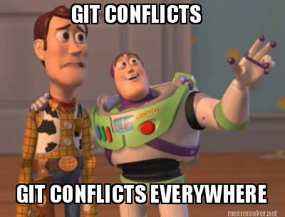
Without Branching
Huge argument about pushing incomplete code
Most tempting & easiest solution reached: JUST WAIT
Worse scenario: everyone pushes week of deadline

Slide 33
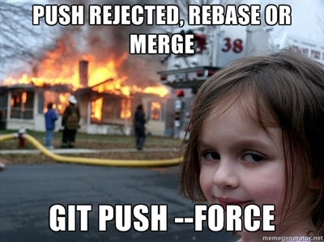
Without Branching
Huge argument about pushing incomplete code
Most tempting & easiest solution reached: JUST WAIT
Worst scenario: everyone pushes day of deadline

Slide 34
Benefits of Branching
Allows developers to work independently
Changes and updates saved in version control
Total independence not needed; others can join branch
Always able to prune branch and rejoin rest of team
Not everything is success, simplify if/when backing out
Merge branch into master when work is complete
Should not interfere with others; you got it working!

Slide 35
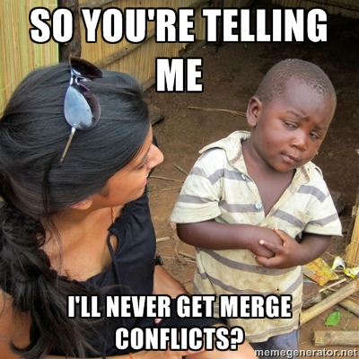
Benefits of Branching
Allows developers to work independently
Changes and updates saved in version control
Total independence not needed; others can join branch
Always able to prune branch and rejoin rest of team
Not everything is success, simplify if/when backing out
Merge branch into master when work is complete
Should not interfere with others; you got it working!

Slide 36
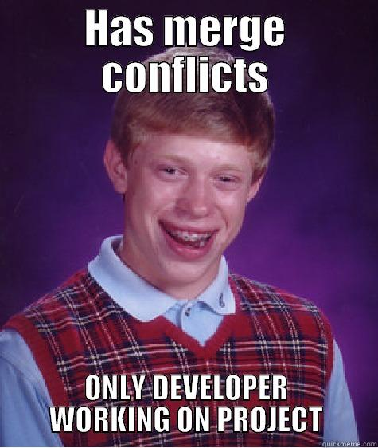
Benefits of Branching
Allows developers to work independently
Changes and updates saved in version control
Total independence not needed; others can join branch
Always able to prune branch and rejoin rest of team
Not everything is success, simplify if/when backing out
Merge branch into master when work is complete
Should not interfere with others; you got it working!
Limits time solving conflicts (for most developers)

Slide 37
Branching in git
git checkout –b <newBranchName>
Creates new branch in repo named <newBranchName>
Local system will now use branch (until merged back)
Could instead use two separate commands:
git branch <newBranchName>
git checkout <newBranchName>

Slide 38
master and develop
Two standard branches commonly used in git
Default that & one initially used is master branch
Often create develop branch for experimental code
Only store code for stable releases in master
Every version tagged so can always find where you were
In worst case, always have solid, stable code available
Never used directly; merges added after thorough testing
Team keeps completed features in develop
Code being readied for inclusion in next product release
Gauge completion by testing develop for stability

Slide 39
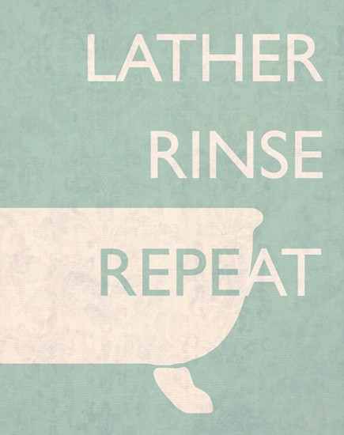
master and develop
When time to release new version draws near….
Commits stored in develop merged into master
master subjected to final tests for any latent bugs
Once ready, add tag to identify version used in release
…& repeat: continue work in develop for next pass

Slide 40
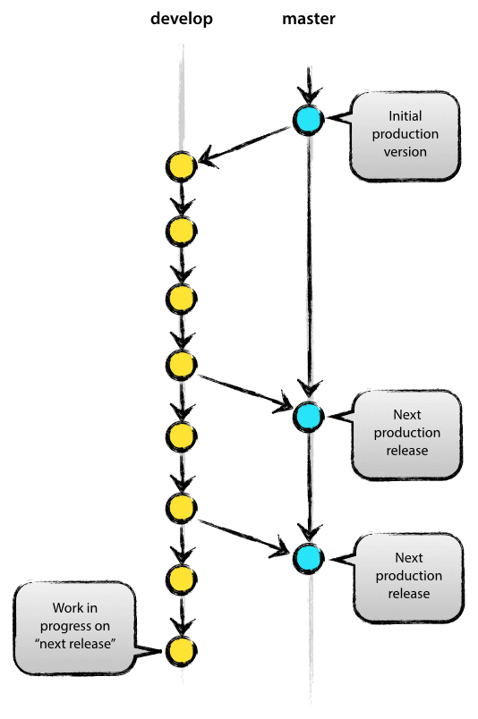
Standard Model for git

Slide 41
Developing Each Feature
Between releases branch off develop not master
Defines unit of code added back to project
Selectively merging part of branch impossible
Fine having many branches developed in parallel
With branching cheap, often create one for each feature

Slide 42
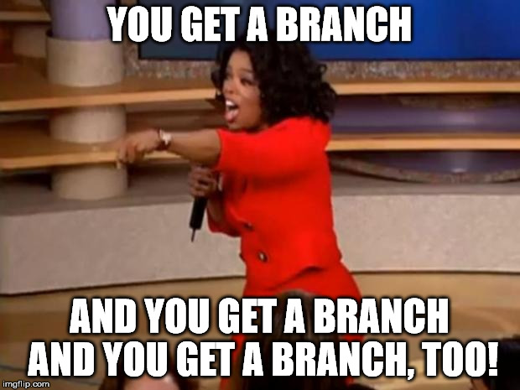
Feature Key Point
Between releases branch off develop not master
Defines unit of code added back to project
Selectively merging part of branch impossible
Fine having many branches developed in parallel
With branching cheap, often create one for each feature

Slide 43
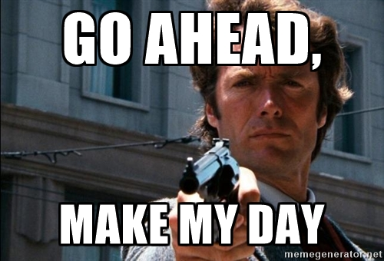
Developing Each Feature
Some, but not all, features work as expected
Avoid confusion: delete branches where ideas failed
Review code before merging into develop
Or, & often done, just hope develop does not break
master remains safe so still better than nothing

Slide 44
Merging: A Comparison
Merging With fast-forwarding
Merging Without fast-forwarding
Command to be used: git merge
Changes merged & branch existence lost
git history complex from lack of data
Demands good commit messages & useful tags
Command to be used: git merge --no-ff
Changes merged, but branch existence kept
Branch development process can be seen
Helped by good commit messages & useful tags

Slide 45
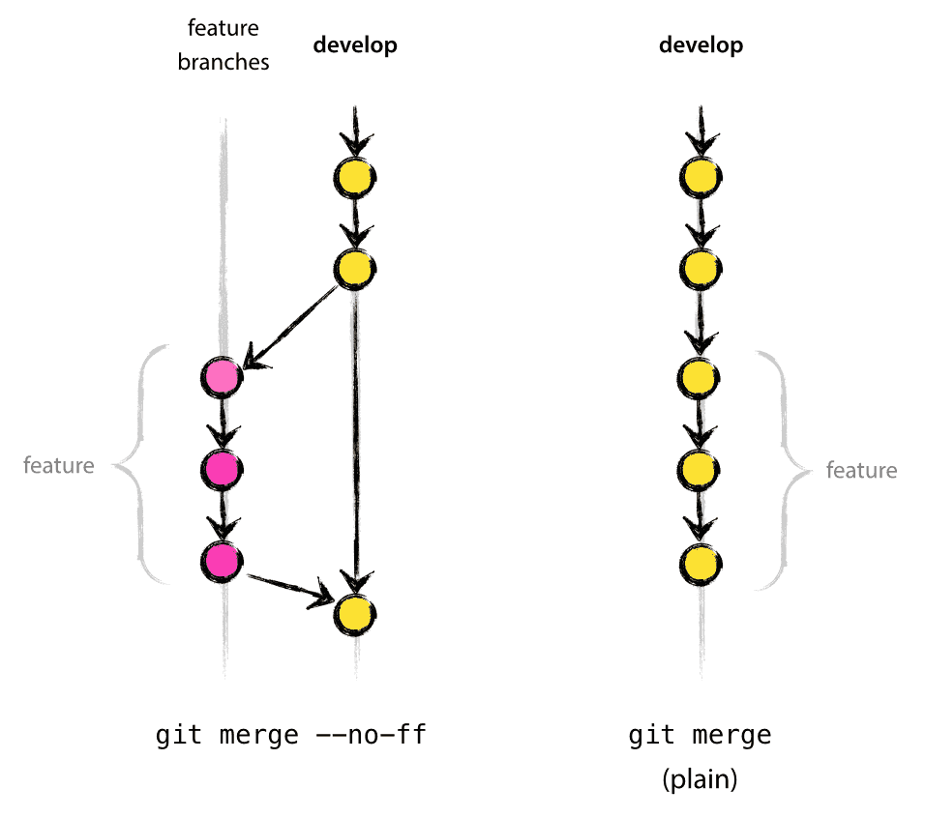
Merge History Comparison

Slide 46
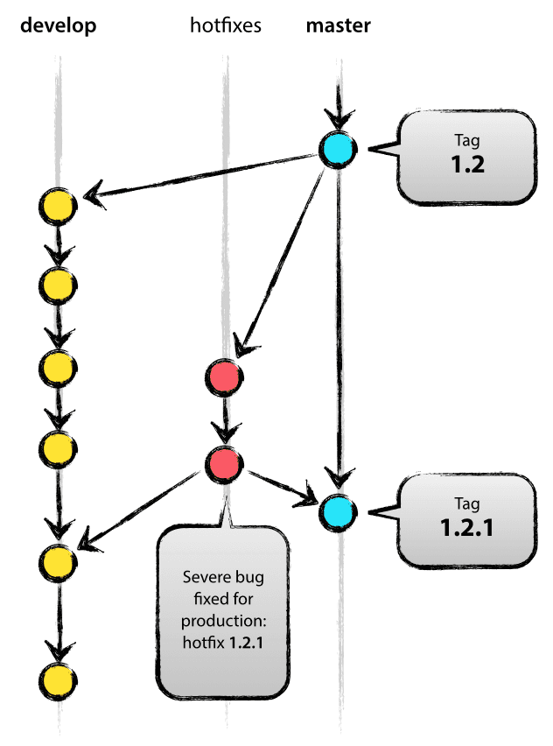
Bugs (& Hotfixes) Happen
Notes:
Hotfix merged to both branches

Slide 47

Picture of Good git Repo

Slide 48
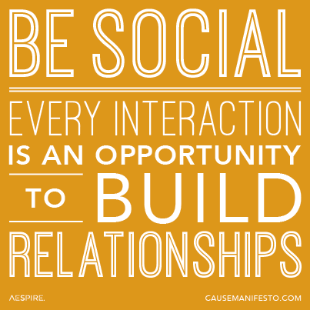
Important Life Lessons

Slide 49

Listening to Your Clients

Slide 50
What Is a Requirement?
From a popular trade book: “It’s a
specific thing
your system has to do to work correctly”

Slide 51
What’s the Problem?
Often see moving target problem
Requirements change immediately after creation
Continue to change until project ends
Stationary target difficult enough when coding
Are all your programming assignments simple?
Changing requirements complicate this even more

Slide 52

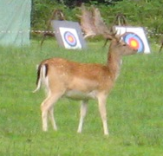
What’s the Problem?
Often see moving target problem
Requirements change immediately after creation
Continue to change until project ends
Stationary target difficult enough when coding
Are all your programming assignments simple?
Changing requirements complicate this even more
vs.

Slide 53

Why Do They Change?
Requirement is contradictory or inaccurate

Slide 54
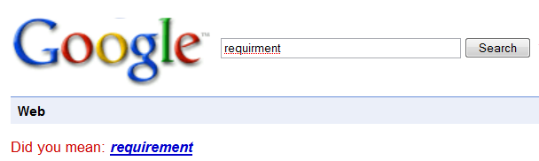
Why Do They Change?
Requirement is contradictory or inaccurate
“Want” v. “Need” conflated by clients at start

Slide 55
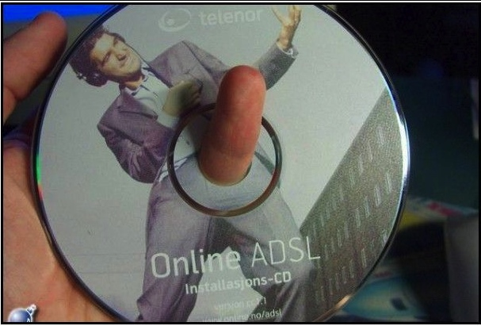
Why Do They Change?
Requirement is contradictory or inaccurate
“Want” v. “Need” conflated by clients at start
Problems communicating with designers & coders

Slide 56
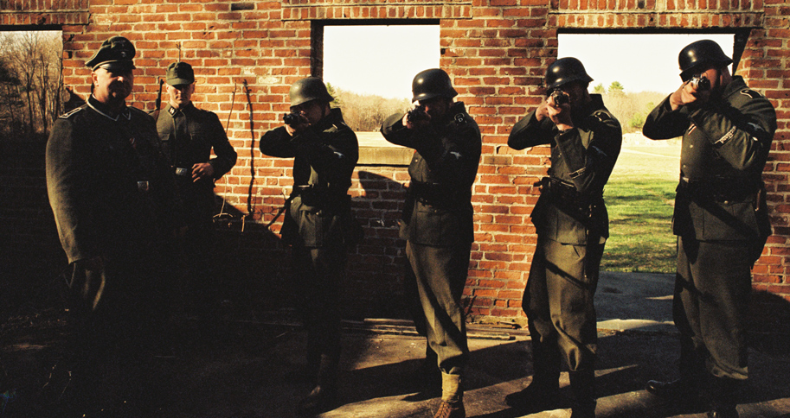
Why Do They Change?
Requirement is contradictory or inaccurate
“Want” v. “Need” conflated by clients at start
Problems communicating with designers & coders
Client changes their mind later on in the process

Slide 57
All Are Same Problem!
Communication

Slide 58
All Are Same Problem!
Communication
Must ensure every detail is explicit
Keep dictionary of important terms
Result of each requirement clearly explained
Notes:
Need to keep customer from changing mind
- Be certain you know what they are saying
- Be certain they know what they are saying
- Defer decisions as long as there is other work to do

Slide 59
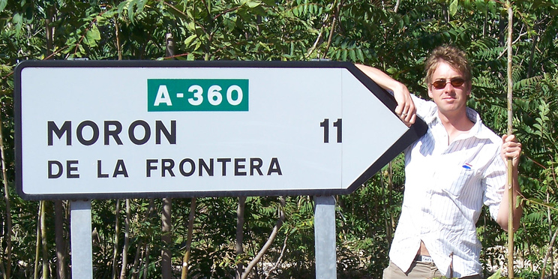
All Are Same Problem!
Communication
Must ensure every detail is explicit
Keep dictionary of important terms
Result of each requirement clearly explained
Can you explain it to
Notes:
* If really unclear, consider using a more appropriate life cycle

Slide 60

Is It Really This Bad?
Set of requirements must be meaningful to
Client

Slide 61
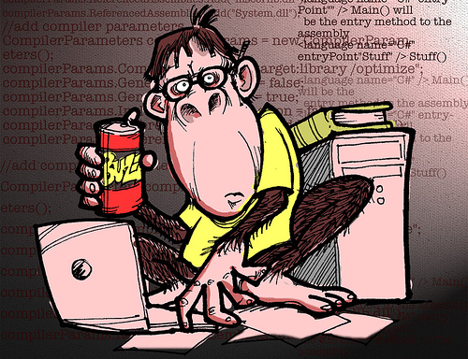
Is It Really This Bad?
Set of requirements must be meaningful to
Client
Designers
Developers

Slide 62
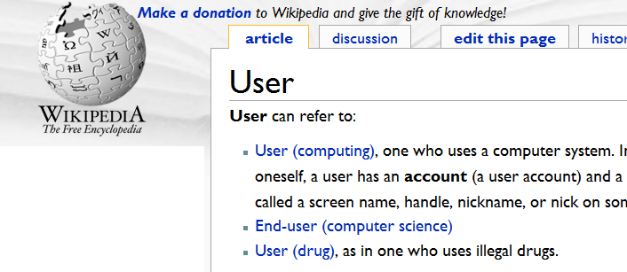
Is It Really This Bad?
Set of requirements must be meaningful to
Client
Designers
Developers
Users

Slide 63
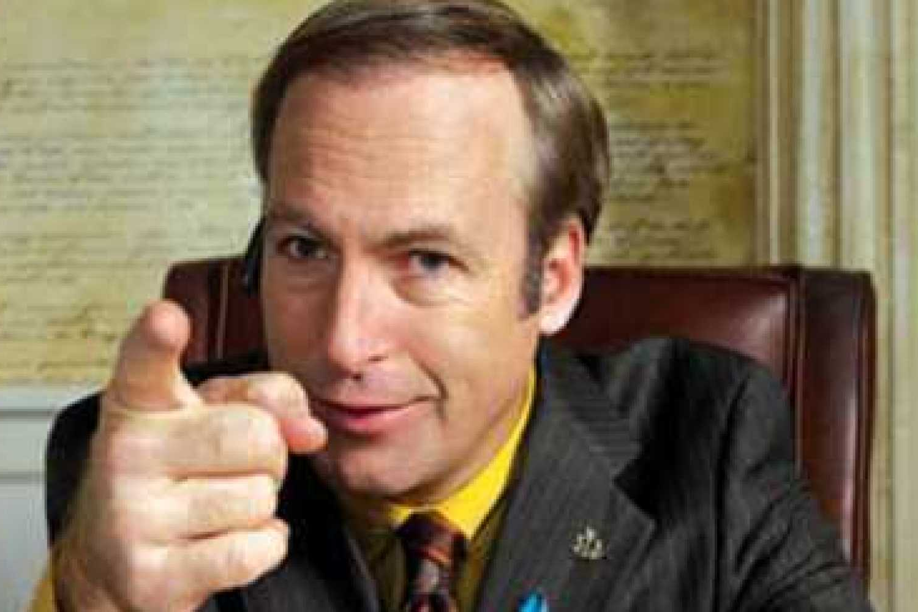
Is It Really This Bad?
Set of requirements must be meaningful to
Client
Designers
Developers
Users
Legal

Slide 64

How To Do This?
Stories are your hammer
Provides insight into client’s goals
Interactions specified & discussed
Within story show cause-and-effect
Testing script created for free
People ♥ stories
Document stories at multiple levels
Visual, explanatory, outline important

Slide 65
How To Do This?
Stories are your hammer
Provides insight into client’s goals
Interactions specified & discussed
Within story show cause-and-effect
Testing script created for free
People ♥ stories
Document stories at multiple levels
Visual, explanatory, outline important
But what details should we include?

Slide 66


Too Much vs. Too Little
Too Much
Too Little

Slide 67
Too Much vs. Too Little
Doing nothing is losing, so do not even think it
Limit use cases to highlight only important details
What & why, not how, included in these models
Will still be able to find astonishing number of bugs
Many details unusable or useless or both
Including these would waste good web surfing time
Clients do not understand or care about these details
Fewer details == more time ogling “too little”

Slide 68


Too Much vs. Too Little
Doing nothing is losing, so do not even think it
Limit use cases to highlight only important details
What & why, not how, included in these models
Will still be able to find astonishing number of bugs
Many details unusable or useless or both
Including these would waste good web surfing time
Clients do not understand or care about these details
Fewer details == more time ogling “too little”

Slide 69
Use Case Basics
Must be of some real value
Serious requirements documented only
Important system uses from user’s perspective
Needs to define clear starting & stopping events
Why do we care about requirement?
How would a user know its over?

Slide 70
Use Case Start
Needs to have external initiator (actor) trigger
Player

Slide 71
Use Case Start
Needs to have external initiator (actor) trigger
Player
Dealer

Slide 72
Use Case Start
Needs to have external initiator (actor) trigger
Player
Dealer
Pit Boss

Slide 73
Use Case Start
Needs to have external initiator (actor) trigger
Player
Dealer
Pit Boss
Fluffy

Slide 74

Use Case Start
Needs to have external initiator (actor) trigger
Player
Dealer
Pit Boss
Fluffy
Gravitational wave

Slide 75
Use Case Start
Needs to have external initiator (actor) trigger
Player
Dealer
Pit Boss
Fluffy
Gravitational wave
Anything outside the system
Starting event must be clearly defined
Occurs when external initiator interacts with system

Slide 76
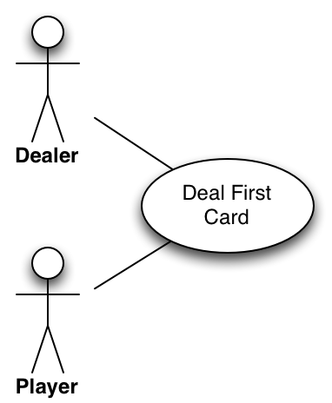
Deal First Card Use Case
Dealer indicates start of round
Place card, face up, before each player & dealer

Slide 77

Deal Second Card Use Case
Deal one card, face up, to each player
Deal one card, face down, to the dealer

Slide 78
Deal Second Card Use Case
Deal one card, face up, to each player
Deal one card, face down, to the dealer
Where is the external initiator?
What event starts use case?
Why should the user care?

Slide 79
Use Case Requirements
Each use case examines exactly 1 use of a system
All 3 parts of action included in use case
Start
Middle
Goal

Slide 80
Use Case Requirements
Each use case examines exactly 1 use of a system
All 3 parts of action included in use case
Start
Middle
Goal

Slide 81

Use Case Requirements
Each use case examines exactly 1 use of a system
All 3 parts of action included in use case
Start
Middle
Goal
Only Deal First Card has start condition
Probably should combine them into single use case

Slide 82

Deal Cards Use Case
Dealer indicates start of round
Place card, face up, before each player & dealer
Place card, face up, before each player
Place card, face down, before dealer

Slide 83
Deal Cards Use Case
Dealer indicates start of round
Place card, face up, before each player & dealer
Place card, face up, before each player
Place card, face down, before dealer
What if blackjack was dealt?
When do we check?

Slide 84

Use Case Requirements
Each examines exactly 1 use of a system
All 3 parts of action included in use case
Start
Middle
Goal
Use cases must accomplish their goal
Important to reach clear stopping point

Slide 85
Deal Cards Use Case
Dealer indicates start of round
Place card, face up, before each player & dealer
Place card, face up, before each player
Place card, face down, before dealer
Check if dealer has blackjack
Needs to work for user; we MUST tell story
Still a story, even if different outcomes possible

Slide 86
Off the Beaten Path
Main path shows simplest case to follow
What else might happen shown in alternate paths
Showing possibilities is part of use cases value
Provides chance to walk client through what happens
Lets you ask “What if” & make sure answer handled
All details should be made as clear as possible
Easy test generation given this walk through
Good way to check problem understood

Slide 87
Deal Cards Use Case
Dealer indicates start of round
Place card, face up, before each player & dealer
Place card, face up, before each player
Face-down card placed before dealer
4.1 Discover dealer’s cards total 21
4.2 Set that all players have lost and take their money
4.1.1 Compute player hit 21
4.1.2 Mark player won and pay out at 1.5 times bet

Slide 88
Deal Cards Use Case
Dealer indicates start of round
Place card, face up, before each player & dealer
Place card, face up, before each player
Face-down card placed before dealer
4.1 Discover dealer’s cards total 21
4.2 Set that all players have lost and take their money
4.1.1 Compute player hit 21
4.1.2 Mark player won and pay out at 1.5 times bet
Is this use case clear?
Have we communicated everything?
Can we be certain no information lost?

Slide 89
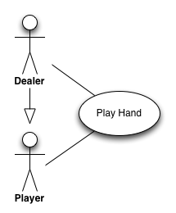
Play Hand Graphical Use
Actors are stick figures in this representation
Use stick figure even when actor is not person
Display generalizations using open arrow
We always represent use case as oval
Lines connect actors to use cases it is involved in
When referring to use case, underline its name

Slide 90

Goal!!!!!
Each use case must state explicit goal
What is done, when it ends, & its value are specified
Important properties of each use case’s goal:
Clear
Explanatory
Short

Slide 91
Play Hand Use Case
Goal: Deal the cards & then complete the remainder of the hand. Pay out any monies as needed.
Outline Goes Here…

Slide 92

Boss’s Reaction
What? I’m not paying for this!

Slide 93
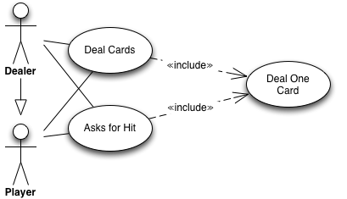
Relations between Use Cases
Boss likes to see code being reused
Lots of common tasks in these complex use cases
Diagrams unclear whether tasks must be identical
Documenting this saves money in long run
Split out these common tasks using «include»
Separate ideas are own use cases & written as such
Only chance to have use case refer to other use cases

Slide 94
Relations between Use Cases
Boss likes to see code being reused
Lots of common tasks in these complex use cases
Diagrams unclear whether tasks must be identical
Documenting this saves money in long run
Split out these common tasks using «include»
Separate ideas are own use cases & written as such
Only chance to have use case refer to other use cases

Slide 95

Boss’s Reaction
These are too long; we must split them

Slide 96
Oops
Use cases do not include temporal properties
Leads to long, complex use cases that are hard to use
Better to split but requires stating carry-over details
How to communicate these requirements?

Slide 97
Preconditions
Specify what is needed for case to work
Make it explicitly clear what the assumptions are
What needs to happen before use case begins?
Tell your story assuming preconditions met
Provides another test of your requirements
Serves as contract within system
Must work if preconditions were met
If not met…

Slide 98
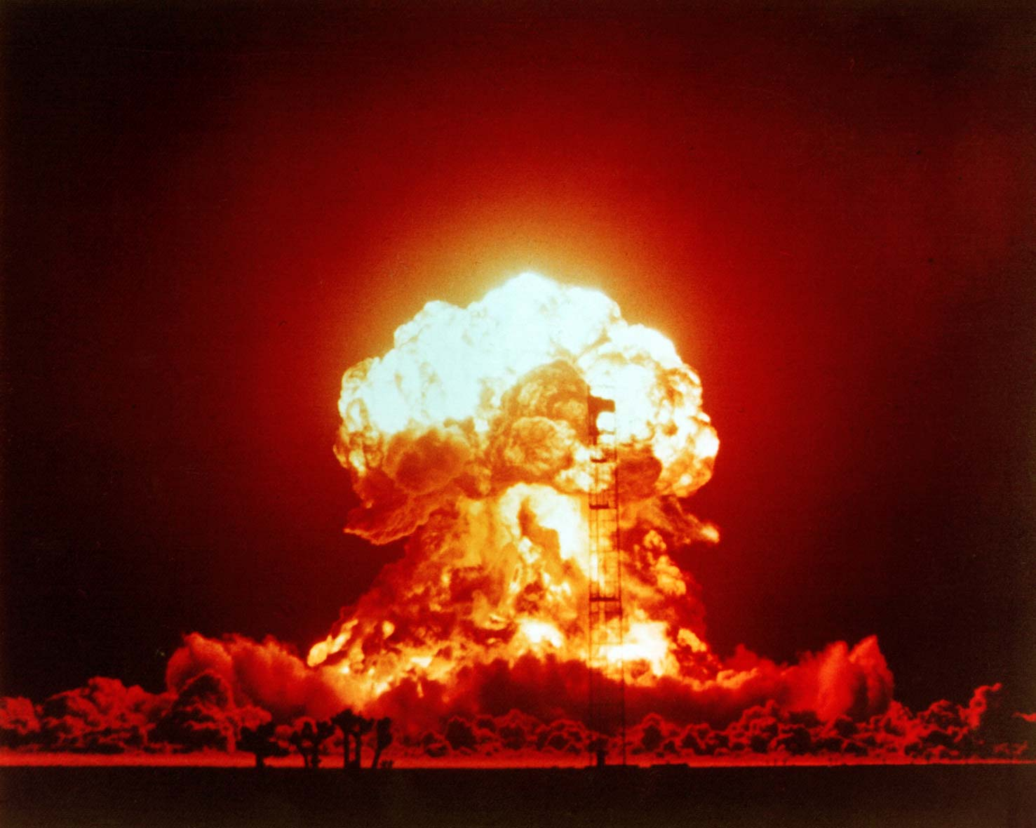
“Not My Problem”

Slide 99
Deal Card Use Case
Goal: Deal card to the next player who needs it
Preconditions:
Player’s score is below 21
Player currently active in the hand
Already started dealing this hand

Slide 100

Once More Into the Breach
How do I know where preconditions met?

Slide 101
Postconditions
Specify what is true once complete
Clarifies tasks performed by use case
Works no matter if main or alternate path taken
Helps testing system once requirements complete
Preconditions need matching postcondition
Develops required ordering of included cases
Analysis assumptions are clarified
If there is a precondition without postcondition…

Slide 102
“Still Not My Problem”

Slide 103
Use Case Basics
Needs to have a real value to the system
Do not waste client’s time on useless issues
Specific event starts the use case
Begins when triggered by external initiator (actor)
Must be outside system to count as an actor
Use case must always end with some event
Multiple interactions included in some use cases
Not always clear, important to consider users’ view

Slide 104
All Use Cases Document
Goal
What it does, when it ends, & what its value is
Preconditions (most often saying “none”)
What must be true before starting use case
Use rarely when splitting complex use cases needed
Outline Representations
Tell a story in formal, standardized business format
Postconditions
When use case completes facts must hold
Defined for all use cases no matter what the type

Slide 105
Use Case Suites Include
1 graphical representation showing all uses cases
Includes exactly 1 instance of each external actor
Includes bubble for per use case in requirements
Provides easy, simple visualization of:
Which actors included & what may have been missed
For each actor line connects to use case(s) they are in
Shows generalizations (inheritance) of actors

Slide 106
Use Case Problems
Good example of tech analysts making decisions
Every detail captured for later use in project
Assumes everyone comfortable with finicky format
All requirements important & will be implemented
Spares no expense completing long, formal processes
But when changes occur, use cases not helpful
Creating each use case is time-consuming & expensive
Hard for clients to understand; limits ability to disagree
When prioritizing work, hard to determine want v. need

Slide 107
User Stories to the Rescue
Lightweight approach for capturing requirements
Story documents single system interaction by user
Details will change so does not waste time on them
Needs fluctuate, so requirements readable by client
Explains why requirement needed to allow prioritization

Slide 108
User Stories to the Rescue
Lightweight approach for capturing requirements
Story documents single system interaction by user
Details will change so does not waste time on them
Needs fluctuate, so requirements readable by client
Explains why requirement needed to allow prioritization
When change expected, can better use resources
Cheap to create since user story often single sentence
May never be implemented, so eschews most details
Keeps focus on conversation rather than processes
Waterfalls need not apply, common in iterative models

Slide 109
User Story Basics
Short statement of customer values and wants
User’s view of feature described often in first person
For each feature, explains why user wants/needs it
Story should be testable: successful results shown
Provides enough detail to create further client dialog
Each story often a sentence, rarely more than two

Slide 110
User Story Basics
Short statement of customer values and wants
User’s view of feature described often in first person
For each feature, explains why user wants/needs it
Story should be testable: successful results shown
Provides enough detail to create further client dialog
Each story often a sentence, rarely more than two
“The gambler comes up and places his bet.”

Slide 111
User Story Basics
Short statement of customer values and wants
User’s view of feature described often in first person
For each feature, explains why user wants/needs it
Story should be testable: successful results shown
Provides enough detail to create further client dialog
Each story often a sentence, rarely more than two
“The gambler comes up and places his bet.”

Slide 112
User Story Basics
Short statement of customer values and wants
User’s view of feature described often in first person
For each feature, explains why user wants/needs it
Story should be testable: successful results shown
Provides enough detail to create further client dialog
Each story often a sentence, rarely more than two
“As a gambler, I place my bet.”

Slide 113
User Story Basics
Short statement of customer values and wants
User’s view of feature described often in first person
For each feature, explains why user wants/needs it
Story should be testable: successful results shown
Provides enough detail to create further client dialog
Each story often a sentence, rarely more than two
“As a gambler, I place my bet.”

Slide 114
User Story Basics
Short statement of customer values and wants
User’s view of feature described often in first person
For each feature, explains why user wants/needs it
Story should be testable: successful results shown
Provides enough detail to create further client dialog
Each story often a sentence, rarely more than two
“As a gambler, I want to play blackjack so I place my bet.”

Slide 115
User Story Basics
Short statement of customer values and wants
User’s view of feature described often in first person
For each feature, explains why user wants/needs it
Story should be testable: successful results shown
Provides enough detail to create further client dialog
Each story often a sentence, rarely more than two
“As a gambler, I want to play blackjack so I place my bet and get dealt a hand.”

Slide 116
User Story Basics
Short statement of customer values and wants
User’s view of feature described often in first person
For each feature, explains why user wants/needs it
Story should be testable: successful results shown
Provides enough detail to create further client dialog
Each story often a sentence, rarely more than two
“As a gambler, I want to play blackjack so I place my bet and get dealt a hand.”

Slide 117
Be Wary of Details
“As a gambler, I want to play blackjack so I place my bet and get dealt a hand.”
How is a bet is placed?
Possibilities include credit cards, chips, implantable IDs
This may change, but does not affect the players desire
Each story is part of a dialog may not be fully formed
Negotiations on details occur when stories developed
Many ideas never get coded, this avoids losing time

Slide 118
User Story Outline
“As a <role>, I want <goal> so I <action with testable result>.”
Most common template used for user stories
But these are stories, so templates not required/used
Lots of roles exist among the users of a system
Customer representative (or clients) present most ideas
Others may exist: big betters expect special treatment
Team brainstorm roles and see if stories might change
Bring ideas back to conversation: client has final say

Slide 119
User Story Outline
As a <role>, I want <goal> so I <action with testable result>.

Slide 120
Stories Are Writing
Storytelling & writing are skills like any other
Kids’ stories hard to follow and often have no point
With age & lots of practice they will improve

Slide 121

Be Social!

Slide 122
Sprint Grading Part 1
10 minutes: document ease of onboarding developer
Project cannot stop for job changes (which do happen)
Explain how repo allows newbie get up-to-speed quickly
Progress on user stories & tasks associate with each
Likely next steps based upon current state of tasks
Simplicity of classes & commit message helpfulness
Entire team helps present & answer questions
Score shared by team & one-third of phase total

Slide 123
Sprint Grading Part 2
10 minutes: demonstrate release from end of stage
Must be in runnable state & stored on USB flash drive
Demo machine chosen by me: should work anywhere
Functionality added in sprint demonstrated & explained
Continue ability to run past work identified & shown
Show acceptance & unit tests pass using source code
Entire team helps present & answer questions
Score shared by team & one-third of phase total

Slide 124
Sprint Grading Part 3
10 minutes: individual understanding of code
Individually answer question on current implementation
Fundamental to Scrum is collective ownership
"I did not work on that" unacceptable response
Having notes or using documents in repo encouraged
Completeness of response is 26% of phase total
Last 8% of phase grade uses average from rest of team
Tell me EARLY when teammate not pulling weight
Grade will not suffer because teammate unwilling

